Slide 1

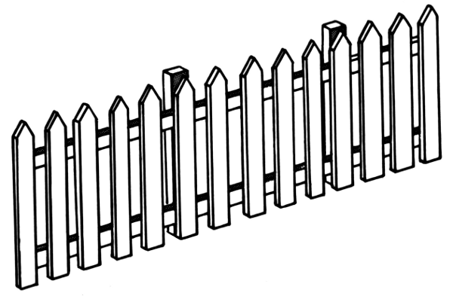



Slide 2



“Two frogs jumped over the fence, but two frogs didn’t jump over the rock.”

